Slide 1
Team Name:
Team Leader Name:
Project Name:
SOLUTION
PROBLEM STATEMENT
[Technology Stack]

Slide 2
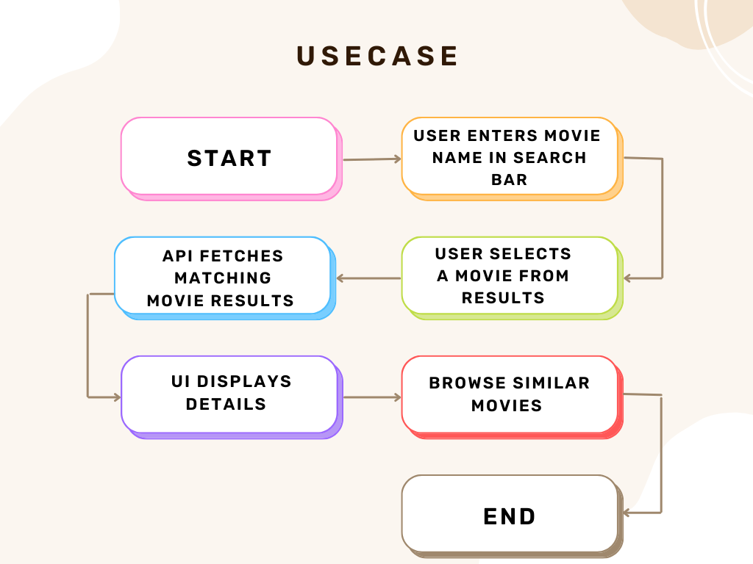
[Workflow Diagram]

Slide 3
[Advantages]
[Dependencies]

Slide 4
Revenue Model / Business Model (If any, optional)

